Slide 1
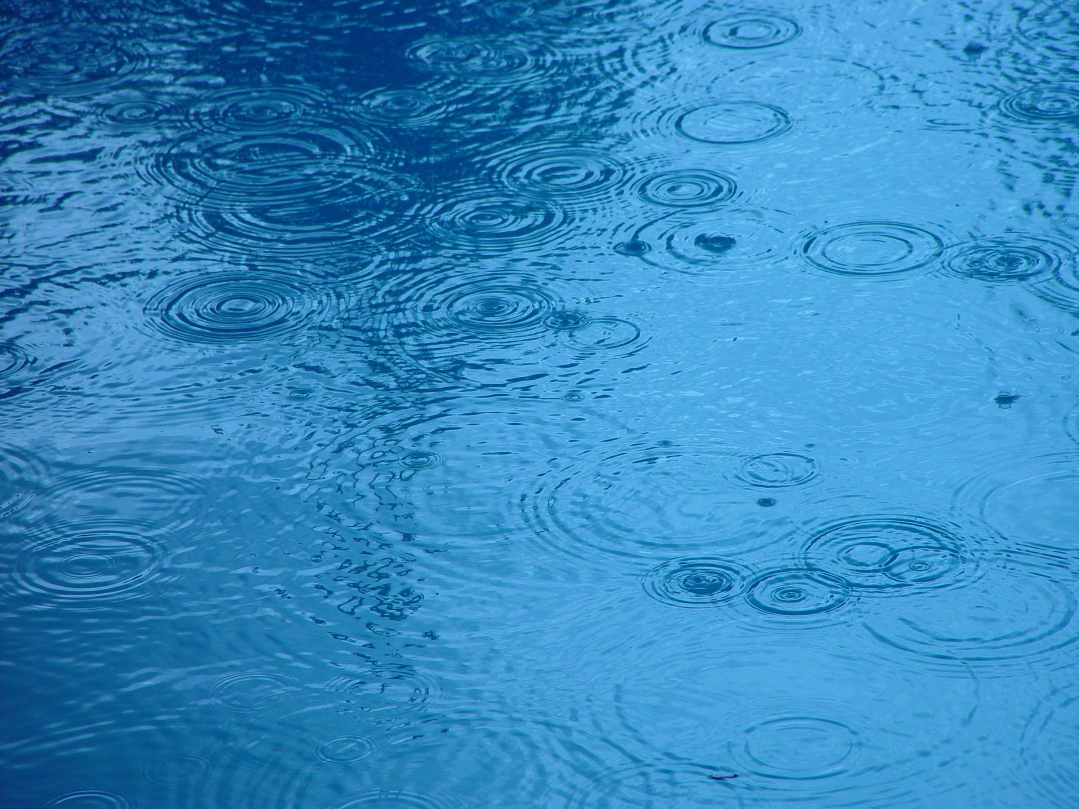
Why Water?
By: Marissa Skrivan

Slide 2

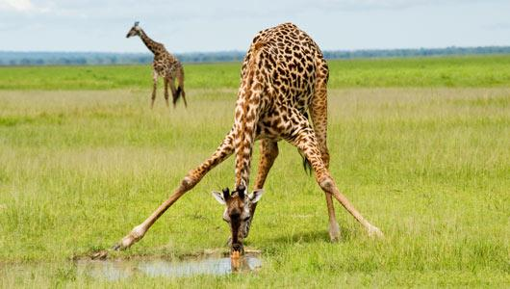
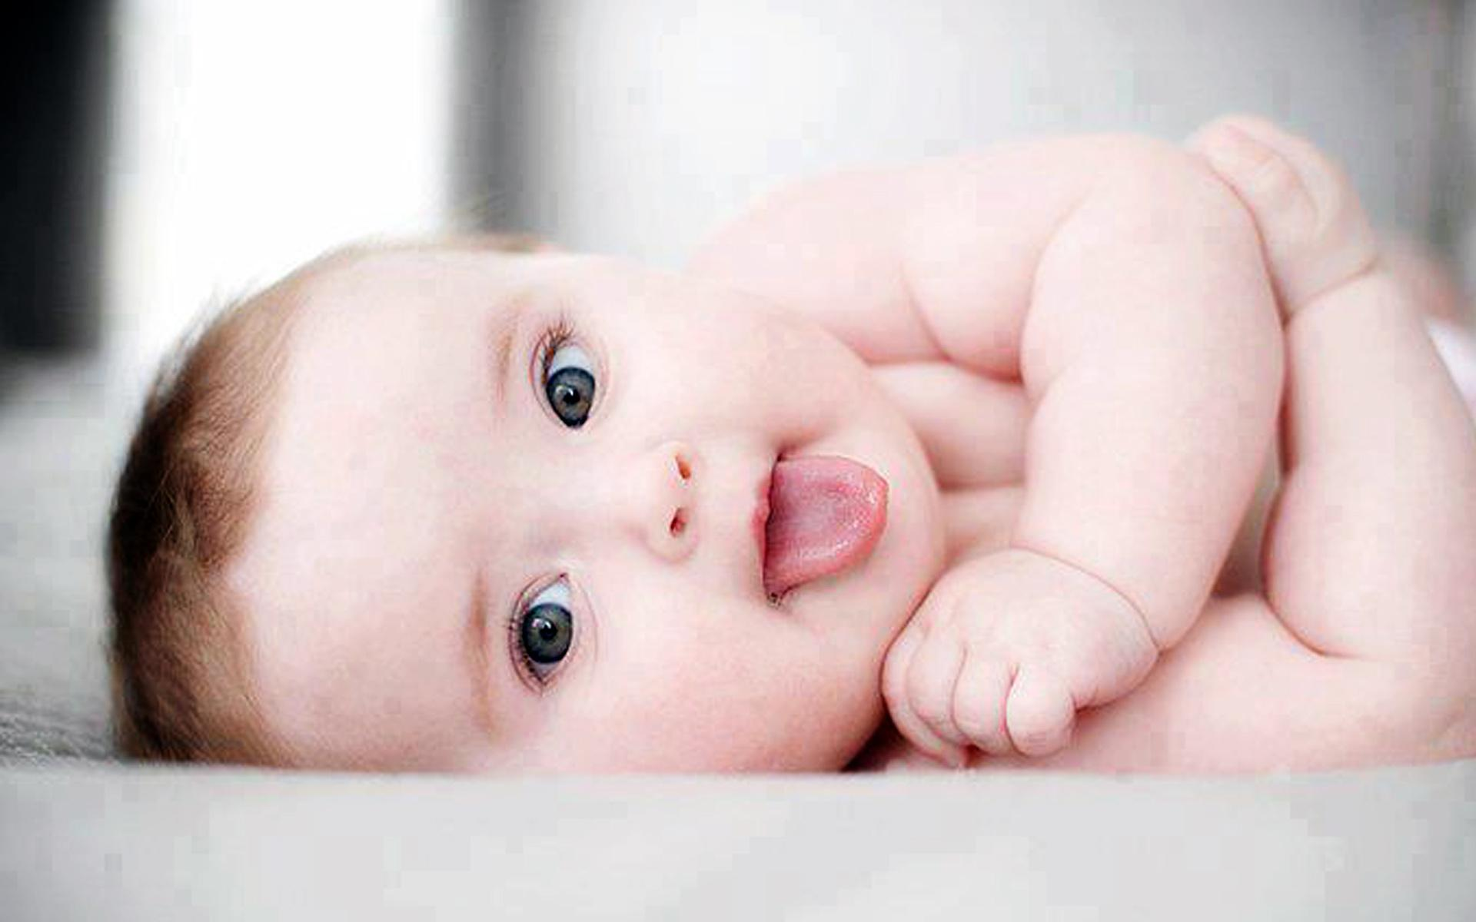
Water is an amazing substance. Water has many characteristics that are rarely seen and haven’t been found together in any other substance. It is so unique to itself and that is why it is the foundation of life: plant, animal, and human. We are about 60% water; it is essential to the life of our cells and, therefore, us. Water is a main part of reactions that take place in our bodies and keeps us alive.

Slide 3
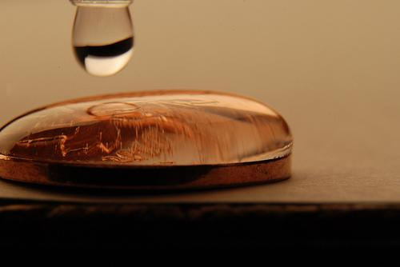
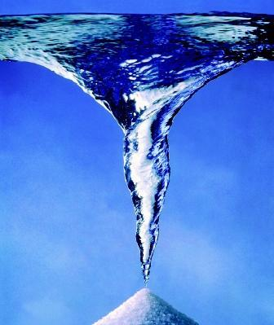
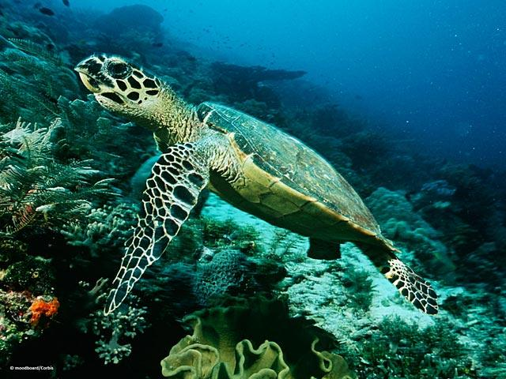
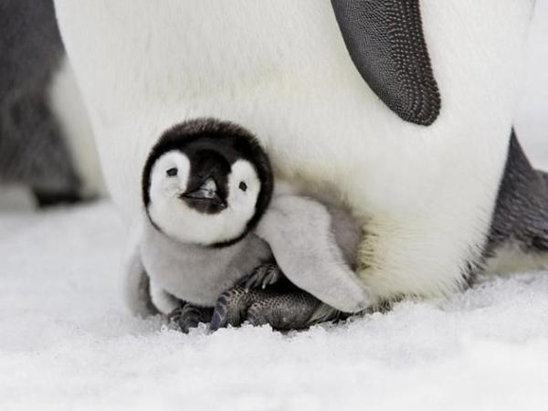
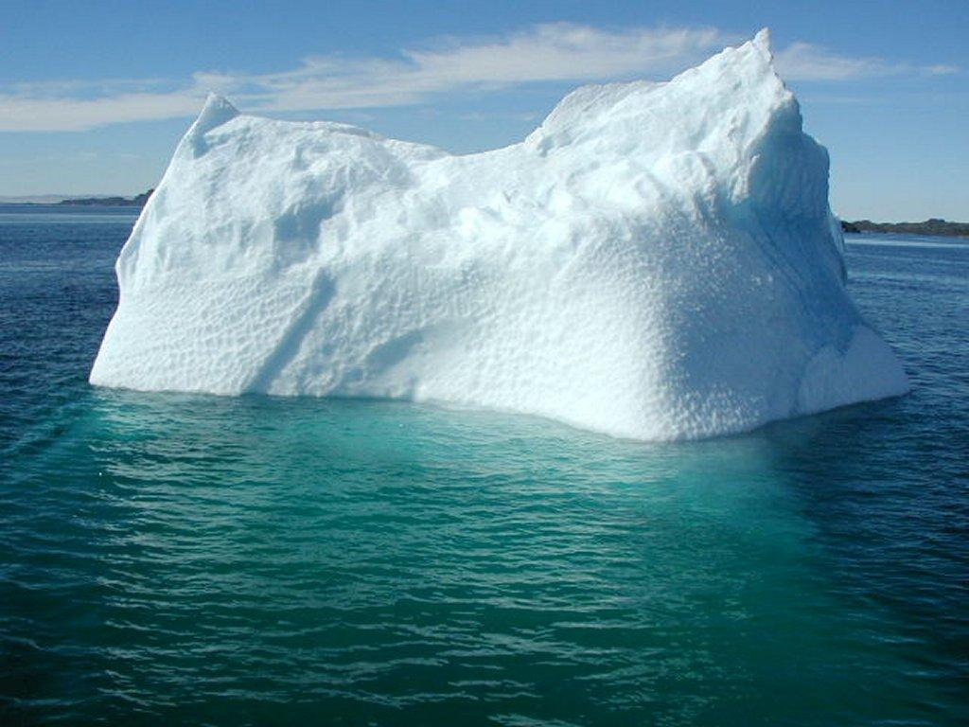
The Science
Cohesion
High Specific Heat
Density When Frozen
Life’s Solvent

Slide 4
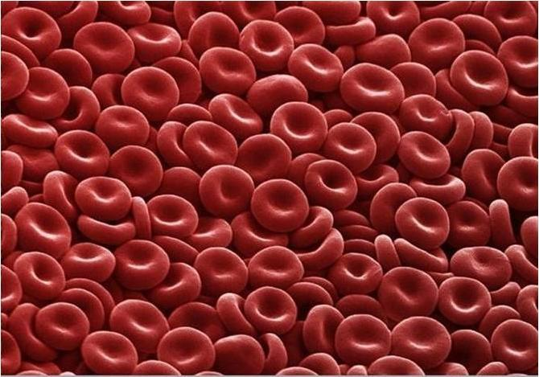
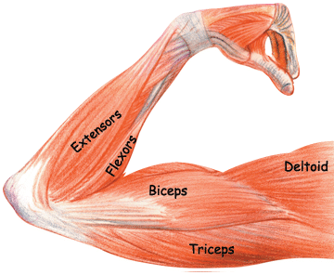
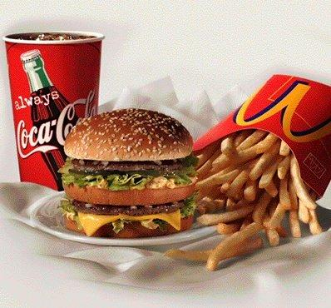
Benefits
Digestion, Circulation, Absorbance
Toxins
Kidneys, Muscles,
and Cells

Slide 5
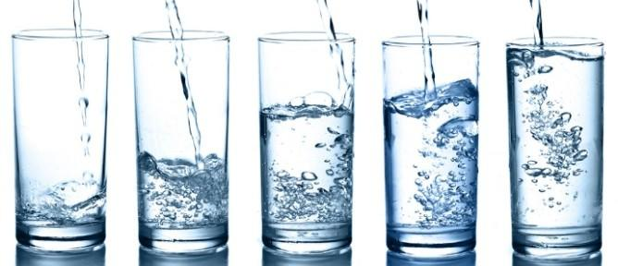
Eight 8-ounce Glasses of Water?

Slide 6
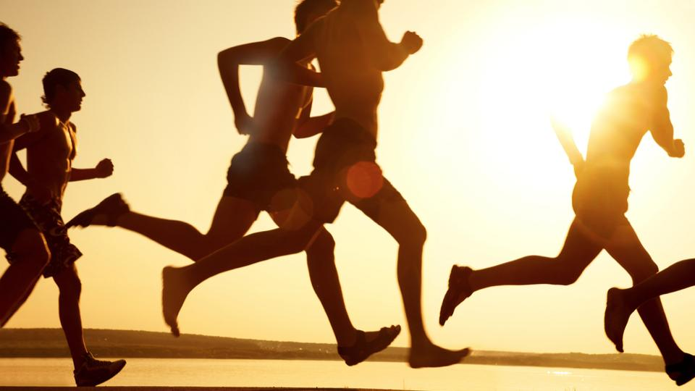



Exercise
Pregnancy
Illness
Environment

Slide 7
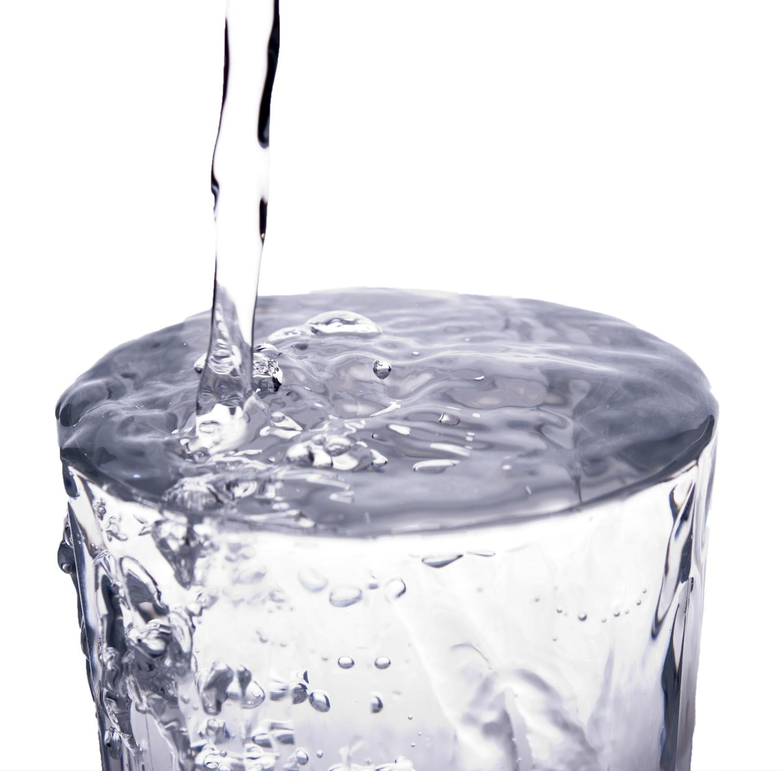
More?
How much water should I drink in a day?

Slide 8
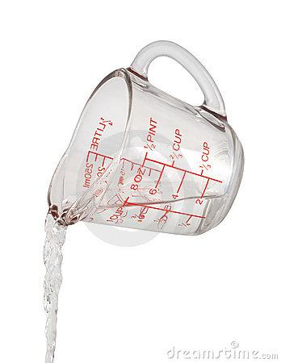
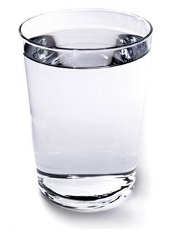
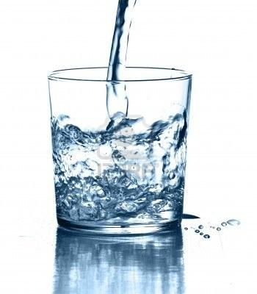
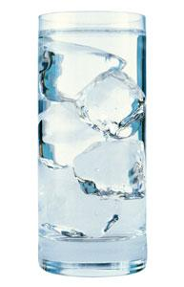
In A Day:
9-13 Cups?
Half Your Body Weight?

Slide 9
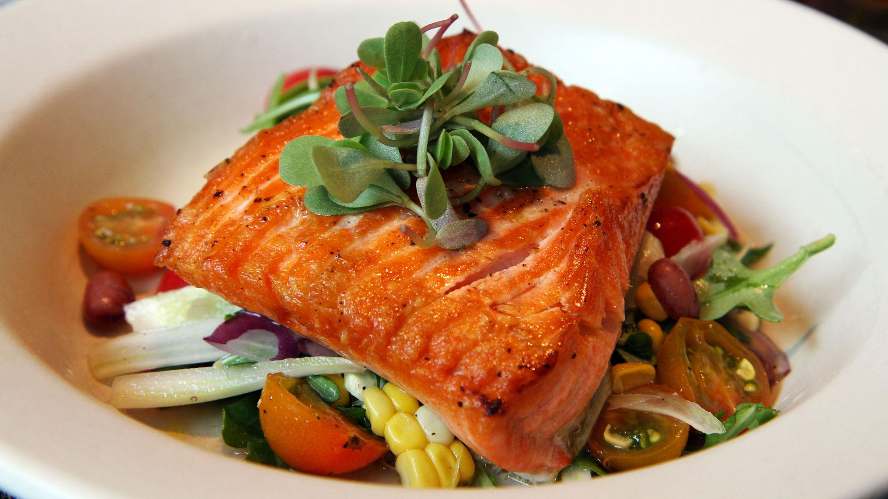
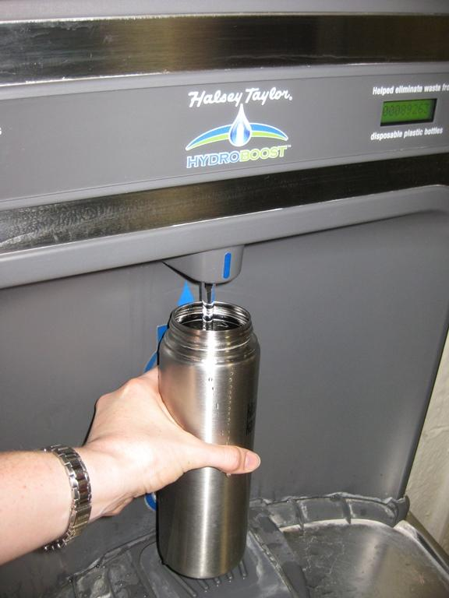
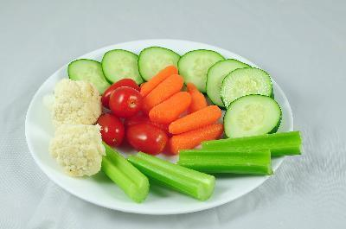
How to Keep Drinking:
Drink Water With Meals
Keep Water with You
Eat Vegetables

Slide 10
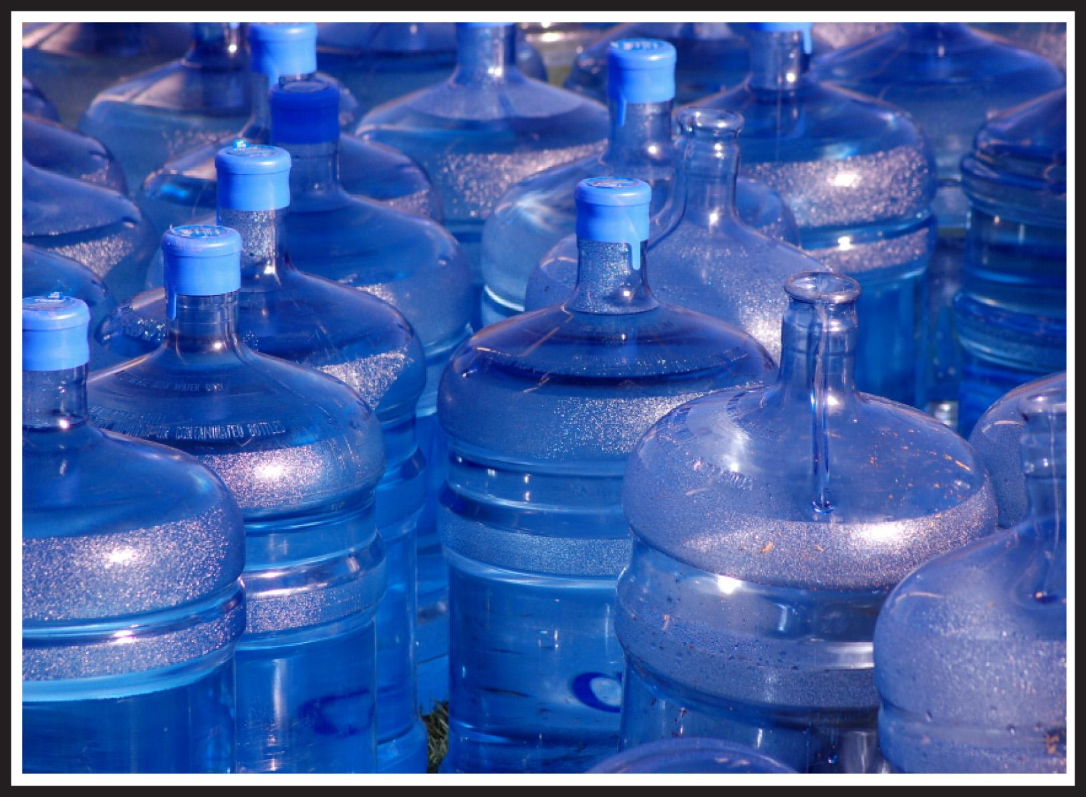
Hyponatremia
Can you drink too
much water?

Slide 11
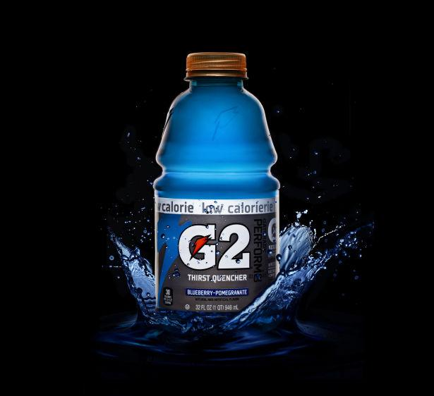
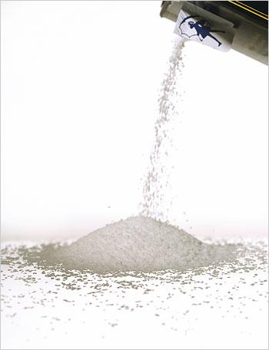
Electrolytes
Sports Drinks

Slide 12
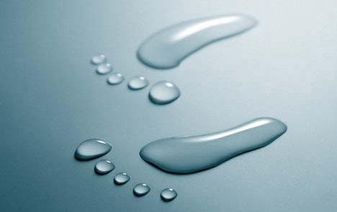

Slide 13
Works Cited
C.R. Nave. (n.d.). Retrieved from
http://hyperphysics.phy-astr.gsu.edu/hbase/chemical/watersol.html
Elkaim, Y. (2013). The truth about how much water your should really drink. Retrieved from
http://health.usnews.com/health-news/blogs/eat-run/2013/09/13/the-truth-about-how-muc
h-water-you-should-really-drink
Mayo Clinic Staff. (n.d.). Retrieved from http://www.mayoclinic.com/health/water/NU00283
Obenschain, C. (2012). Wondrous ways that water can improve your health. H2O does more for
your body than quench your thirst, Retrieved from http://health.usnews.com/health-new
s/articles/2012/07/17/wondrous-ways-that-water-can-improve-your-health?page=2
Zelman, K. (n.d.). Retrieved from http://www.webmd.com/diet/featuresb/6-reasons-to-drink-water

